Slide 1







KRS Advanced Project
Team
4.20

Slide 2



Life X Lane
Emergency Vehicles Smart Traffic Management

Slide 3


About Us
Our team is dedicated to improving emergency response times by providing a clear path for emergency vehicles. Our innovative IoT device alerts all vehicles in the emergency vehicle's path, allowing for a smooth and swift response to help save lives with our technology.

Slide 4
Problem Overview
~30%
Deaths
20 - 25mins
~1 in 10
Response Time
Deaths in Mumbai due to ambulance stuck in traffic

Slide 5

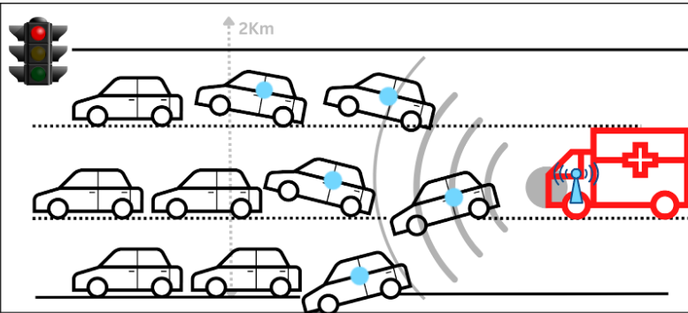

Proposed Solution
This device will just act as an informer passing all the necessary data to thee cars stuck in traffic and also allow some extra emergency services.

Slide 6
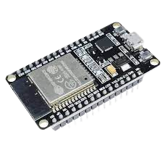
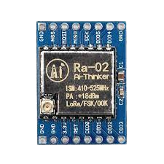
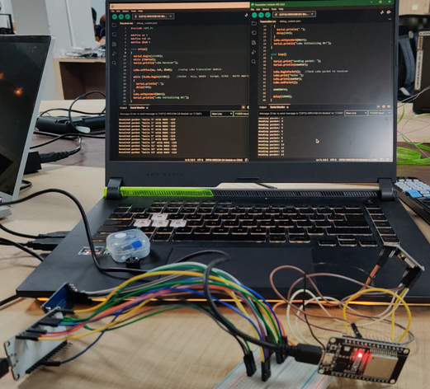
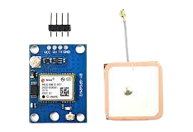
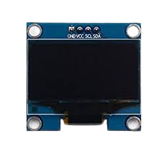
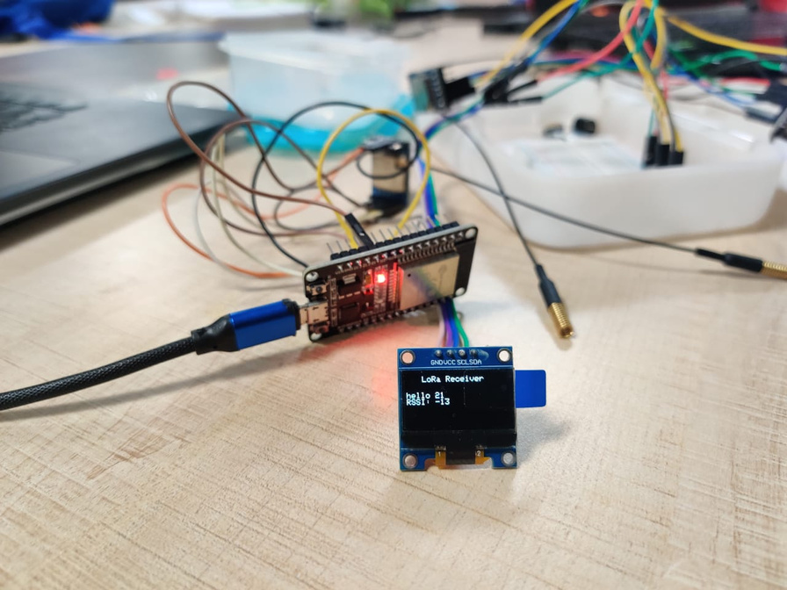



The Device
TRANSMITTER
RECEIVER

Slide 7

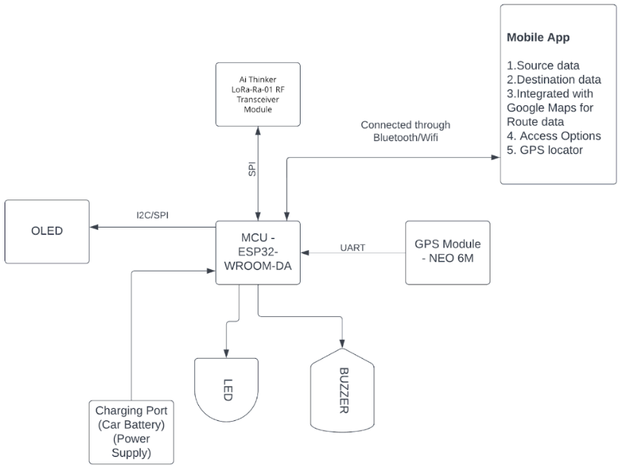
Architecture

Slide 8




Key Features
RF Transceiver
GPS
SOS

Slide 9


APP INTERFACE
Primary Use
More Options
Login/SignUp
Multiconnect
SOS services (data transmit)
Entire Route with Progress
Red Flag
Establish connection between mobile and Device to exchange data
Transmit Source, Destination, and Waypoint
Receive route of incoming emergency vehicle

Slide 10

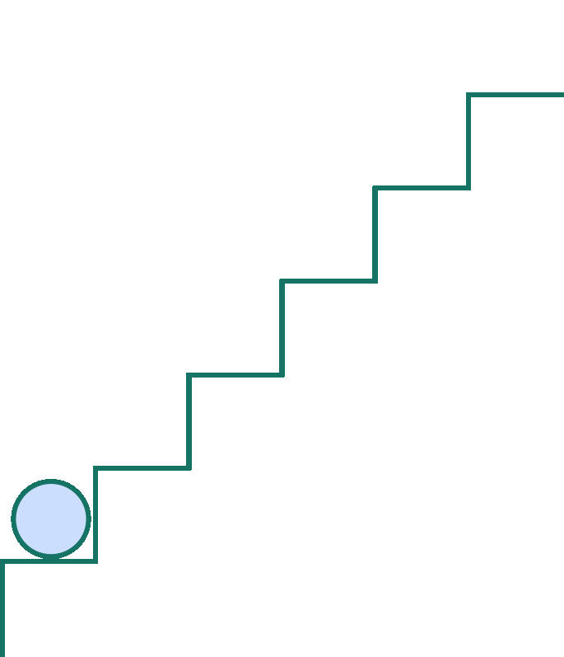





TIMELINE
Problem Overview and Ideation
Requirement Analysis and Prototyping
Unit Testing, Incremental evolution and refinement
Industrial Deployment and Real time use

Slide 11
Roadmap
Done
To be Done
Future Scope
Idea Generation
Abstract Construction
Project Presentation
Basic Prototype Creation
Future Scope Evaluation
Feasibility Study
Requirement Analysis
Base Demo Coding
Complete Prototype
API Integration
Unit Testing & Refinement
Complete Application
SOS
Live Tracking
Emergency Prioritizing
Fleet Management
KYC verification

Slide 12


Emergency, meet Technology.
With our project, we're planning to revolutionize the road to rescue, creating a flashpass, making it smoother, faster, and more effective for people in crisis.

Slide 13


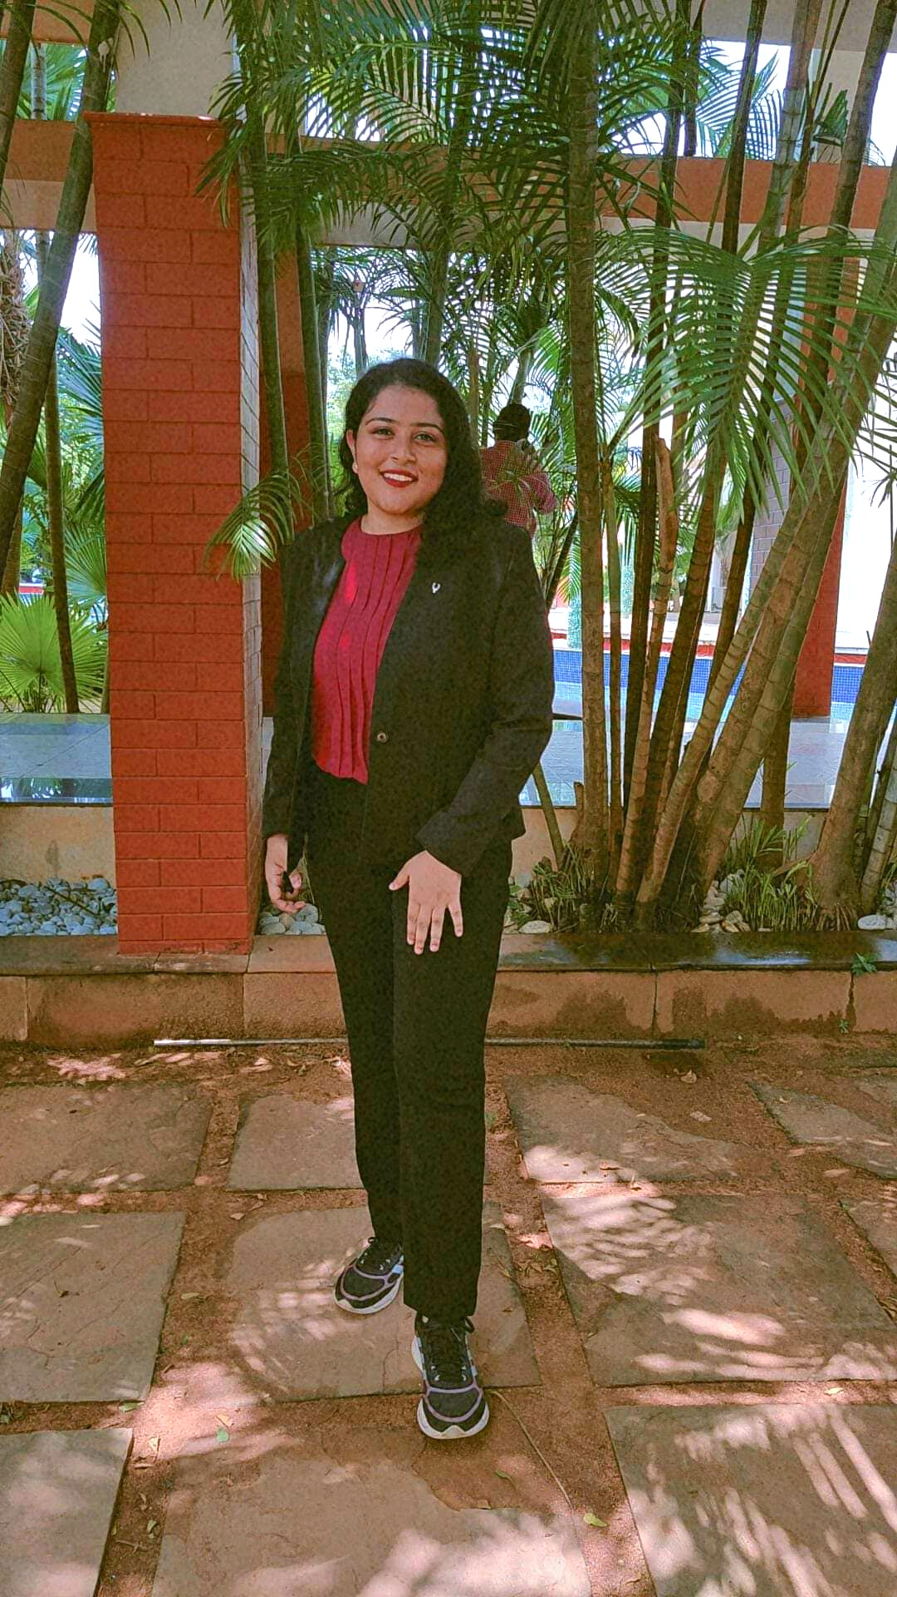


Team
Sohini Joarder
Kishan Kumar Alok
Chief Circuit Builder
Deputy Wiring Wizard

Slide 14



THANK YOU!
20051108@kiit.ac.in : Sohini Joarder
2005807@kiit.ac.in : Kishan Kumar Alok
SCE, KIIT University, Bhubaneswar

